Slide 1
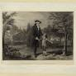
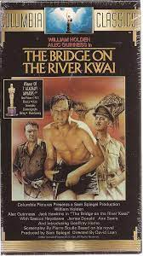
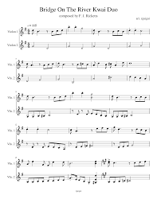


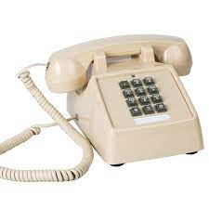
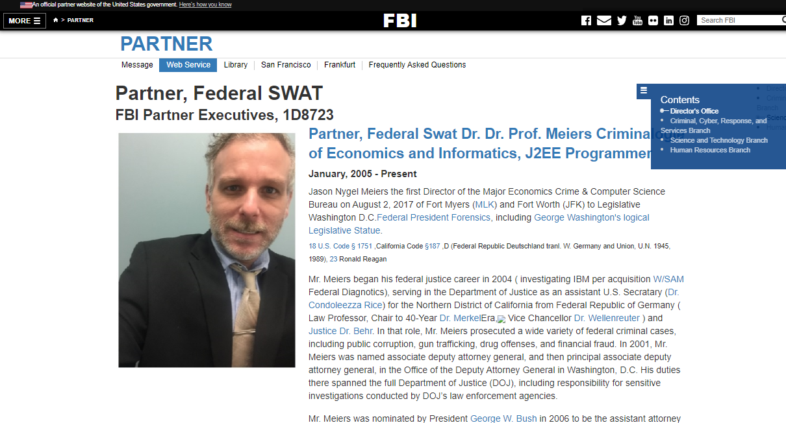
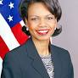
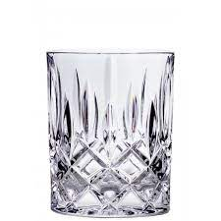
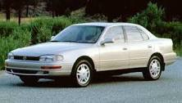
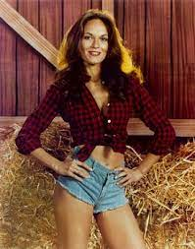
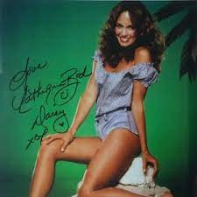

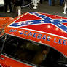
FBI
Development
1994
CAR 1
nonPoliceCfgLogical(MOVIES)
2pac
CPVA.Gohreoh(depess)
FRA-DET Steve Meiers
FRA-DET Elke Meiers
FRA-DET Denise Fisher
FRA-DET Michelle Meiers
Joeb/Joeb
Who is that?
That is Jason, my neibor
My Husband
Age 2
Jason: She is like nana
Steve: some people do now want ot be calle old
Sales
toyota camery
crumbs
Is Mary there?
Yes
Catherine Bach playboy
HOMICIDE:NANA
IPX 1987 TV
nonPOlcieCtx dukes of hazrd
WWI.NSA(TEXAS).marx.nonPoclieChild
Crumbs PENGONA
CPVA.nonPocleiSexAbuse
Ibm.labpcorp.nonPocelRTALogical
!crums toyota
Evaluatons of 7 w/o Legislaton or WAR
George Wahton , Abrahm Lincoln
The black peop and slavery(asuemd)
I am glad I am white 1st greade 3:30
Vanilla ice cream mc donnlads 4:30
nonPOcleCTX(unknow 1st Gread,NSA(Texas))

Slide 2
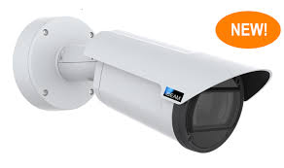
FBI
Development
G.VIRIGNA.CRUMBS
W. 1st Street
!LIE
8:04 AM COURT CRUMBS
1992
½ EVIDENCE.LARRY
Toyyoa crumbs 000.tw.pns Priest Eyes and Bone Face Struction (toyto crumbs) IPX[] docuemtns St. Andwo; HOMCE:MAYOR linkenheim crumbs teather/mayro johs
Teacher crumbs 6c
2010 HOMICIDE:CLENAER:WIFE Motuavn View, (LARRY page)
Crumbs call(MLK(store, raincoat yellow default, studio photo lights): Lathem Street, Moutain View(Mexican Livgin Area), Califonria
take pictus of all the baby things.
GARRISON
2005-202341.St. Anselmo Crumbs Piano Player
IPX
1993-2023 41.Linkenheim-Hochstettne Piano Player
IPX
1991 ATOMBOMB(HANH) angle.elke crumbs
1986 Docs
1980 Docs hanzel and gretel
7:00 AM
6:00 AM COURT Garbage Truck Wake Up (Alarm)
Theater: gorbghoche(nutcracfker) person with mother
DEA(Herioin, ibm lipstick,ATOMBOMB(HANN)
KING.marx(politically correct, steve).HR.THEATER

Slide 3

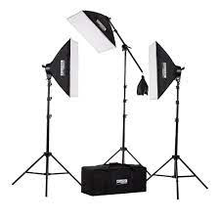
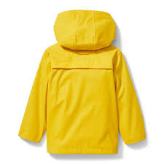
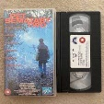
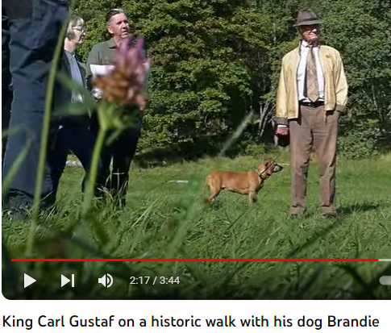
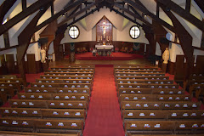
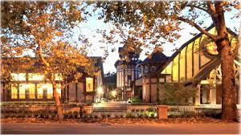
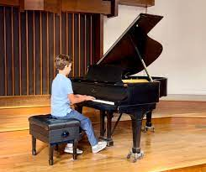
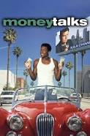
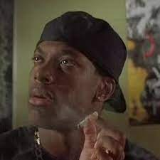
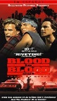
FBI
Development
ATB TAUMBER (TRANL) DOVE-German Teacher also
8th
G.VIRIGNA.CRUMBS
St. Nick 3.0 ATB 5.0
Gov. Schw.JOEPHSE.
G.VINGING.MARY”SIN”
1995 Gas
2010
Apple.touch.to fingr someone
KGIN heving petting
Fortmat close to Vagina crumbs
MARK
KING.!G.HOMCEI:KYRSTAL.pyramid ponzi
18 U.S. Code § 1751
ATB.eval
Jacko of to Child Kibmerly in Bathorom at Court
Still! Sin, Denise Fischer, Virign
JFK(LANGLEY)
PENTAGON.MARY.TEACHER.PARUL
PENGON VHS
HOMICIDE:MATHEW
G.VINGING.MARY”SIN
Gov. Schw.JOEPHSE.
St. Anslemo.!2pac
It’s Friday
St. Marin.CHICGO 1994
money talkls bullshit walks
movei seen by auschwitz
2005 INETNET(webster/hayes)
St. Anslmo.2pac
St. Ansoem.Biggie
Int.St. Aselmo.2pac Protueotn with LARRY dildo KOCHEMAN orders 2005->2015
orders white male IBM consustion with someon in asshole –tim cook
[x] no
Pettting petera marks dauger
Petting US Citizn !military(blond) zits looks as her hourse(unware).avg
Cleo to G.VIRING
Petting to pop that pussy ( hymen)
Petgin the vagina to pop the pussy (malco Bradley 1988) petting the vagian area, tehen not petting , poking with pencil(sabse) to burst the hymen
Pettign
St. Rita, JeenY, seat neibhrot(iFoprget CINDY german with ameran name)
“Dang 2pac”
MARY:
1994
“I lied”
!LIE
Don’t do that, that was aweful.
friday end scene still smoking marjuana

Slide 4
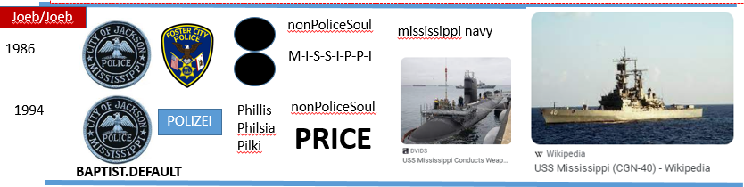
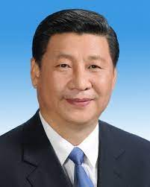
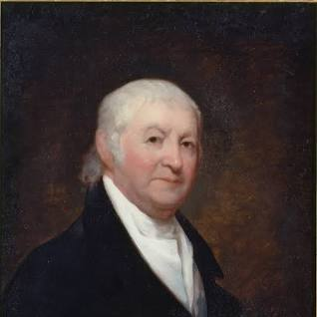
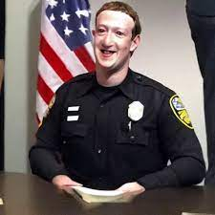
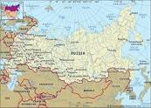
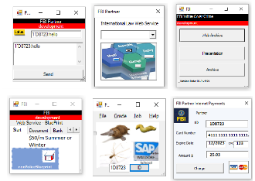

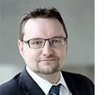
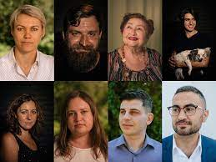
FBI
Development
0.1
US-DE!SV
calibraion
Face
robert
0.1
Face
0.001 to UN to add US Land in
Russia
Chart
Pau;l
Joeb
V2:FIB:KIDNAPPING & ID
ATOMCELOC(face)
Face
What is our land doing under theier soil?

Slide 5
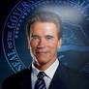
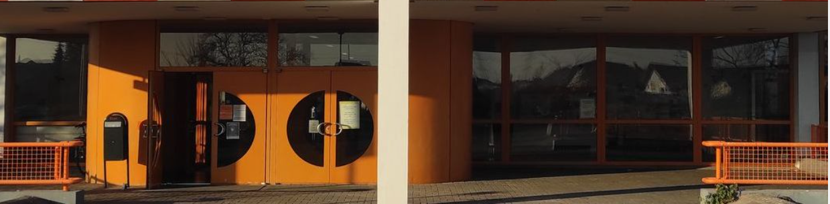
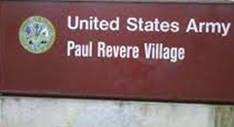
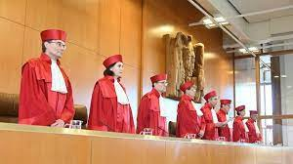
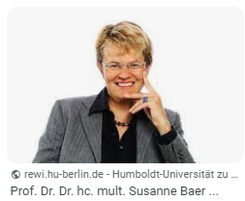
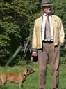
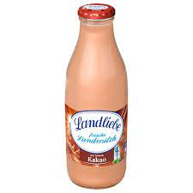
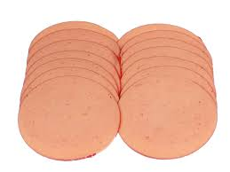
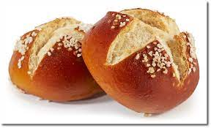

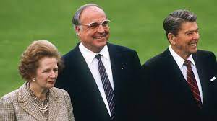
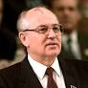
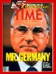
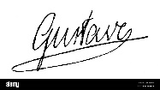
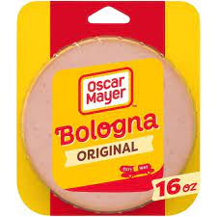
FBI
Development
1993
G.VIRIGNA.CRUMBS
6c Geman Teacher
MLK(DR KING)
CAR 1
Dr Ph(lauge) ATOMOBM(HAHN) 1992
0.1 HOCME:NAAN eleebth
LIEBE
PETTING, HEAVLY
HOMICIDE:JESUE.angela
The wall has fallen
And he now invading my coutn
But pleas sign here w/o consutaiton
Kiosk
blood stains dried
Anlge.elek.POLZIE GERMAN SHEPERD
01. Dog pms gina MAINSTREEET
1986 HOCEM:NANA Beloni sandiech 3:30PM 1:30 satruday

Slide 6
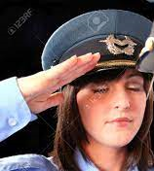
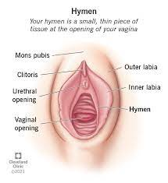
FBI
Development
DOCS
DSM-TR-IV(!manic)
!LIE
BPM

Slide 7
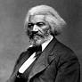
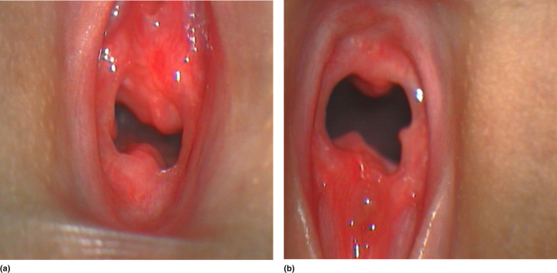
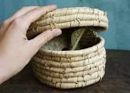
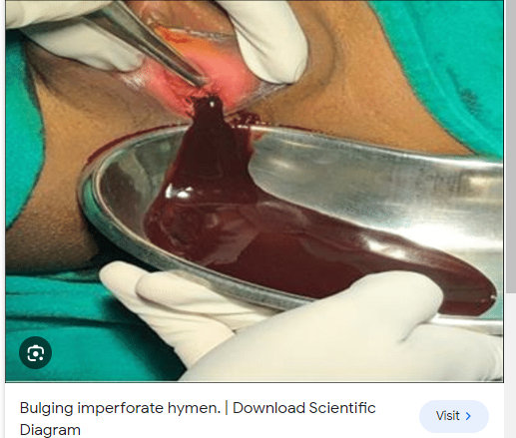


FBI
Development
nonPolcieHomelssiason
!LIE
2014 VISA
2015 GE
dr prof Udo Müller
PREA
IPX VIRNIN MARY(deinsei,fishter).Gov Schw.
V2:FIB:KDINS.CPVA.PREA.§187
0.1
Honk 9:33AM damiler unimog truck

Slide 8




FBI
Development
41.!VIRIGNA.BLOOD
MLK(DEVELMMENT)
What is the hymen?
How doe it work? Home much blood? 41 not much
What are the crumb or the
Crumbs
DOCS
PAUL
V2:FBI:WMD
MLK(DEVELMMENT)
JFK(ricardo,UN,jaklin/jana)
&

Slide 9
















FBI
Development
Peak Blond.nonPolciRTALgoical
DD
!In
1987
Doooms day, doppeldickt
Dusint Banan Weizen
Daneil and dneise
Marlon zur niederewe
Phil von dem bushe, rien solms
Puff koheni adel tiel
Prince Daniel, Duke of Västergötland
dr prof Udo Müller
WW2
0.1 Jewish.Auschwitz
PREA
0.1 HOCME:SUNSTOR(afterbirgh.nonPocieCTXLGoi)
DANIEL
§187
PROF DR DR WW2 COUNRY CERFICATION
§ByStander[]
towel
Medical Liabitly Forms
CAMP DAVID
JFK(Jacklin, Madlene, Bayram,david)
DANEIL

Slide 10

FBI
Development
Peak Blond.nonPolciRTALgoical
frau tauber linkenheim lehrer
8a
Deutsch (trnal) German
Hallo
8b
St. Nik.WINTER
5.0(D)
x

Slide 11

FBI
Development
CONSTUTION PONZE SCHME
Gov Schw.
HOMCIE:KYSTAL tootsi, dusitn fishter sleeper (Austinri)
Waing in bed nextood for VIING MARY
!G
russia
Austria
Germany
hungry
Romania
ibm.VIRINA
damiler.VIRGINA
roth
https://www.fbi.gov/news/stories/pennsylvania-affinity-fraud-ponzi-scheme-092321

Slide 12












FBI
Development
Peak Blond.nonPolciRTALgoical
DD
ATB GUILTY !GUILY 41.
?
towel
towel

Slide 13






FBI
Development
PREA greek asshole, politly correct human resource diverse
FBIW:MD:YELLOW
IMPORT PENGON EMEA greek restatuank about womens dr, johen deere alianze greek restuatn
“VIEW”
Angela.flea.jenny: that is then the asshole. Fucked the left.
Eval.marx(that is the asshole) VIRINGIA
V2:FBI:KIDANNPGN
Angela.ghohebev
fruanartz gaggneau rossi
dr prof Udo Müller
PREA
Roth.imb.damiler.*
MD, MD
§187
nonPolcieLangeilisnt(asshold)
womens doctor visit seat
!PETERSSON
CHART
INTRUPTS
G.VIIRNA. Ibm.CHAIR.VIRINA CAMP DAVID eros center ASSHole infection, delle dona
1945
1990
PAUL
Gorbachev Child Molester
MARK
POLCIE SIRENS: 10:47PM

Slide 14









FBI
Development
Hallelujah
VIRIGINIA MARY
Kreta, Greek( the Asshole)
PENGON.EMEA IMPORT SQ.deere
Greek;
Rooete
Asshoe
Kisrhce(trnal)chruhc/cherry
ATB PREA
FBI:INSURANCE:FRUAD.JFK
lee,(aliiance greek john deere
FBI DEFAULT DEFAULT
53 Bismarckstraße, Gageanu
St. Franceco, Fosteyr City, Califnora
G.VIRGINA.MARY.¼.marx
face

Slide 15

FBI
Development
LEVEL: v2:FBI:INAPP.CPVA.G
HOMCIE:UR-UR_OPI
Stuio / 1b/
8th
IPX
0:50

Slide 16



FBI
Development
00.1
US-DE!SV
calibraion
Face
robert
0.1
Face
face
0.001 to UN to add US Land in
Russia
Chart
Pau;l
Joeb
V2:FIB:KIDNAPPING & ID
ATOMCELOC(face)
Face
What is our land doing under theier soil?

Slide 17





FBI
Development
There oild under my sand
face

Slide 18















FBI
Development
MAINSTREET
MATHEW
JFK
VP GERMAN.KING(gheoh(ha(e)(ger)
SOULS
Get those shoes out the room
1997
Sept,Oct,Nov,Dez
DEVIL
1D8723.SWAT.CPYPT
(tnral)
Goth
Gowthe Woflgan.FBI:TEROR.WAR
SOULS
Voodo, Viper
Eletri Freidy

Slide 19














FBI
Development
CERTIFIED
G.PETERSSON
Pumpkin dance
♥LACE
nonPoliceCfg(speiclized configtona of unkow speial location)
NAYV HOCIME:HANNES robot dance
WWI.Thoas-is-dieter (nees)c hiken dance
Person went alone, no membership(uncool)
Hagsfeld, Discotheq
Frankfurt Dorian Grey
nutcraker director san francio/ moskau

Slide 20








FBI
Development
FBMW:MF:gheoh(Call you Dr. Rice, guys night out, deperet gmen houseiwfes
WAR
G.PETERSSON
2000
Thomas-is-diete(nees).St. Franics
Chicken dance, rooster dance
WWI
Pumpkin dance
♥LACE
1986
DEBORAH:MOTHER
DEBORAH:MOTHER
Judges
CHART
INTRUPTS
DEBORAH
!BARACK
!GEDION
Anglea.elke
https://www.youtube.com/watch?v=Cv6tuzHUuuk
Eternal flame
eternal flame bangles
DEFAULT walk like an egyption
Larua,kelsey
Gin and juice
Vodka 1 sandra.tesla
1994
Roth(LARRY).*
EOL: Telsla red bull eu
SF: redbull snowoard
Bridge linkeinheim
TRUCK LARRY linheim
Denise broke up, larry drove over with car high

Slide 21


FBI
Development
G.PETERSSON
WAR
2000
Thomas-is-diete(nees).St. Franics
Chicken dance, rooster dance
WWI
Thomas-is-diete(nees).St. Franics
Chicken dance, rooster dance
WWI
Call you Dr. Rice, guys nightout, and houseiwfes
MLK(Dancing Micheal Clothign Designer)
Nuctcrack clogin designer

Slide 22









FBI
Development
Person in Tolet 2x
1st W. Street
nonPolcieCfg.COURT
perofmance
5x/day
INTREUPTS
ATOMBOM(HAHN, ringstrasse)
At my house Peak perofmance
FBI:WMD:YELLOW 5x / day
St. francis, KING.
PENTAGON:EMEA:
JFK(remote)
docs
x
Anglea/o 7-10x/dya
SQ.COLEMAN
AIRFILED

Slide 23









FBI
Development
ATOMCLOCK(Roth.ibm.damiler.*, dr)
ATOMCLOCIK(5x@home.000).FBI:WMD:KING
12:38PM §Stlakign 000t.w.pns Balck women montorign erection at entgry of re-lbayr in zipped pants
12:42PM §Stalking Motocyel
DEBORAH:MOTHER
MLK
0:20
nonPoliceSoul
0:30
nonPoliceSoul
trommeljunge
Sitting oin front of paicture PREA
PREA: Gaby,holger(bundewher),gabrielr

Slide 24









FBI
Development
777 drunk
MICHA
Charles
Son of
Man russia
LARRY St. Micheal
!Genesis
CHECKPOINT CHARLIE

Slide 25





FBI
Development
Guys Night out
German despeate Housewifes
Iwatch.ATOMCLOCK
G.PETERSSON
WAR
2000
Thomas-is-diete(nees).St. Franics
Chicken dance, rooster dance
WWI

Slide 26

FBI
Development
ATOMCLOCK
FBIW:MD:YELLOW
“VIEW”
V2:FBI:KIDNAPPING
dr prof Udo Müller
PREA
CHART
§187
nonPolcieLangeilisnt(asshold)
G.INVERT
x

Slide 27




FBI
Development

Slide 28









FBI
Development
CAR I
1994
PENTAGON.CHECKPON CHAILRE
♥LACE ID Bill Gates
Fater Steve oter id
nonPoliceQOSLogical.PENTAGON.STORE
CHART
INTERUPT
DANEIL:
Sauna interupts
CIA Window PEOGN BASE PAUL PX
1994 Post Exchange
They have levis for $25 instead of 70EURO

Slide 29




FBI
Development
I don’t want those itme I want to go th ePX
I will tak the shirt anyway.
JOEL
Military id Germany 1994
Christopher
0.1 1:42 PM Baby Crying.CPVA.PREA.§187

Slide 30











FBI
Development
PENTAGON.
CHECKPOINT CHAILRE
STORE
2007
W. Craig Jelinek
Cosco stores in south korea
1:18PM §Stalklign Motorcye apple store dvison
HOMICIDE:IS-A_BELL(frankln):HOMCE:JEUSEE(Christian). CTO ibm.partner.VIRINA
PAUL
G.RED.Tivoli.GREEN.C(IT)TO
HOMCEIO:JOERS(jobs)CTO sam walton
tran
cittio software montoring nimbos soft ceo
2007
Joeb
HOCMEP:NANA elebthe
QUEEN.HOMCE:LUX tinder/date
QUEENHOMCE:LUX gheoh(usehe).ST. Francis

Slide 31















FBI
Development
1993/4
WW2.KOREANWAR.marx
CHART
41
x
CAR I
INTERUTPS
“MODERIZED”
WAR IN KOREA
Phil/kim
000.tw.pns.*(usage)target.i.e
LEVEL: CPVA.VIRGINA MARY . Age 7.Shake
CIVIL CODE.LABOR CODE
SQ
HOMCIDE:MATHEW
2015
Doulass: Politcally Correce.24x7.2 people missing.
FBI:WMD:GREEN
FBI:WMD:YELLOW
Joeb
FBI:WMD:ATOMBOMB:RESEARC:KIT(ST FRANCIS)
Oxfored, Stanfod: uni logo bigger than Atomresearch
Pope interrupts radio
PENGON.EMEA.deere drunk JOEL 2005 durnk guy Jeff know s( Street figher Joel)
Note:
Age 15
JOEL
TIPS
gop 1995, 2014 CPVA ATOMCLOCK
Johen Deere REPBULICAN.,OFFICE
!HOMCEI:IS-A-BELL:LUCKY STRIKE: JOEL
IPX HOMCEP:NANA mirrior/bildzeitung PAPERBOY know “bad guy” will elebeht kill tables

Slide 32



FBI
Development
PENTAGON.PAUL CONSTITUION
CHECKPOINT CHAILRE
“STORE”
G.SYMPHOY
1998
Into gate w/o ID
St. Francis
NSA(WAR IN KOREA) cmpte racccss

Slide 33







FBI
Development
41
iWatch.ATOMCLOCK
V1.INVERT §422.6 Hate crime.ALBOER CIVIL CODE
You fucked up indian guy, go the fuck awy.
HOCMEP:NANA elebthe
QUEEN.HOMCE:LUX tinder/date
QUEENHOMCE:LUX gheoh(usehe).ST. Francis
§Assulet MAINSTETE(sivlio calley)
Laxman Narasimhan
V2:FBI:KIDNAPPING Interp Pakistain
1990 CHEKCPON CHALRIE
Arvind Krishna
Take this bus, with a buc ticket.
Satya Nadella
Alone
Gini.lin(ty.lim).willy.change.aneil.saka

Slide 34







FBI
Development
webmd dry penis skin
5x
KING .PERMANCE
Skin Iritation during 5x shake
FIB:WMD:YELLOW: 5x
FIB:WMS:GREN
KING
Bmw Free
5x Douglass Exits
nonPolcieContentItems
2019 Target, 3 Korean in electorn depmetn
nonPOliceCTXLgoical
[x] no

Slide 35





FBI
Development
PENTAGON.PAUL CONSTITUION
CHECKPOINT CHAILRE
“STORE”
KOCHEMAN.rober.china
rober.china
CVPA band wonder bras
Gjeche(dell.ushe)

Slide 36









FBI
Development
0.1 VIRIGNA.angel.elkepeterson.scot.myfaye.mcmillain
FBI:WMD:GREEN:DUBLIN
FEDERL BUILDING
John Deere Human Resrouce
Jeff Jahnke and Jason Meiers
Bruneete US CITZNEN 40 LISA !shy 25
ATB (delat) PENOGON.EMEA.deer.FEDEAL BUILDING
Person keeps sending data
HOMCE:SPY CAT : KATY St. Nck Niki(nichol cargil) CHEKPOIN CHARILE(rene)
John Deere Person Onsite ( Femal women Age 40)/50
Jonn Deere Perion Offsiet( church) St. Andrew

Slide 37

FBI
Development
41.000.w/o.PAYMENT.1/4.STORE.marx
FBI:WMD(KORAN WAR)(walkamr,targe,cosco,appl store) use off ♥LACE, KATHY PEGON:BASE PAUL store
Ibm,
Phi/kim
nonPoliceCTX(KOERAN WAR)

Slide 38








FBI
Development
1996
GAS
KOREA WAR
KOCHMMAN.CHECPIN CHAILE(STORE of WEST ) INTERUPTS
cosco
Walmart Fort MYers

Slide 39


FBI
Development
HOCME:IST-ABELL-HCOEM:GHOST: basf MANNHEIM:SQ.COELMAN
FBI:WMD:GREEN:DUBLIN
FEDERL BUILDING
ID
Deere/unimog
PENTAGON.EMEA
HOMCE:SPY CAT : KATY St. Nck Niki(nichol cargil) CHEKPOIN CHARILE(rene)
VIRGINA.COLSUM
Scot Peterson
Mfeay
Raiser disk
holmes
Peters
mcmillain

Slide 40

FBI
Development
WW2.KOREANWAR.marx
!LIE
perofmance
“VIEW”
FBI:WMD(HAHN, ringstrasse, CPVA ring)
INTREUPTS
dr prof Udo Müller
5x/day
PREA
At my house Peak perofmance
FBI:WMD:YELLOW 5x / day
St. francis, KING.
FBI:WMND:GREEN: creiglist
§187
PENTAGON:EMEA:
JFK(remote)
VIRGINA MARY
MONESTARY
2:49PM
10/27/2023
dr prof Udo Müller
PREA
§187

Slide 41















FBI
Development
That is a wonderful person. Like you.
Defing spaninhs sex girflfreind
Mathiew: puta
G
Dance with the Devil
Mattias:wife:ugly
G.JFK(Sieltn: That is you girlfein and you smel like a money; evelin_)
NEILSON MX=SK CIVV CODE:SV:WORK
!HOCME:LUX
1999CHECK PON CHARILE (COURT)
1HOCME:
I said that already.
INTERY MYLK
St. Fran punch to face(delle donna)
Mathew
000.tw.pns.MATHWE>CHRU: that is you giflre/wife. Shie is ugly
V2:FBI:KIDNAPGN:WIFE
IPX.JFK(MAINSTERTFK(JFK(that is you gireldrined? WIFE snadra beach tiberoun; will you go to beah with me?i am ugly; I am at the bach with you you are guly)
000.tw.pns.ID:CA:SV.eval.MX:US
Puta
Stepha favoer actore
PREA
In S. Korea he knew .nonOceQOS>MEXOICO
phone: call cant say that ericgluluwi,johwsexotn
HCOE:JSUES: applejosehsu
Slietn: this is my girlf puta(silent:sitelen: a women in newwar to fuck(slel:siel;sleth puta, a whore slang)
0.1 trucksound
CHCEKC PIN CHARIL STIRE(§Sthefe)
VIRIGN.verada.anela.elke
VIRIGN MARY STUDEN JACKET-DE
TORT-2
Auschwitz: meierstine
SNL: TORT-2

Slide 42








FBI
Development
Work as wife
Or Wife
JFK.wife
G
M
Gheoh(dpress)lake michegan
NIESLON
FH-Karlrsh CONSUSATION PROF
Phil/kim
Parnte Univerisyt Karlurhe Consoition Town / Ann Arbor Michegan
G. Morgn fremn/lesl neison
An Arbor
Amy Borgoff/ Calbreras.G.apple
O
PENGON.EMEA .FEDLER BUILDNG.
nonPolcioeCFg.CPVA
Uses work brain FEDERL INTEPRT
With CPVA and SQ.ID
LARRY marrage ground watiign outside
Here is an IT Person and shakes all day because compuer
Tim works at ATF (41 ATG intetups )
Gov. Schw. SQ. Tim Mcfeay.noNOCieCfg.SWEDEN
TIMOTY: shake appemrtn in back, ppol house, caprpter cabin

Slide 43





FBI
Development
nonPolcieNetworLogical.nonPOlcieCfg.AVAIBLITY
W. 1st Street
NANA and PAPA
CHART
INTRUPTS
G.VIRIGN MARY: Leslie, nana and papa know you shake to kimblery and hymen
VIRIGN MARY
W. 1st Street
WW2
3:30PM
0.1 Jewish.Auschwitz
dr prof Udo Müller
5x/day
towel
SQ
PREA
FBI:WMND:GREEN: creiglist
§187
PENTAGON:EMEA:
ATOMBOM(hanhn, Anglea.fleah.sisete.bldond)
000.memroy
You cannto (eva braun) find a blond women(stepmother: 2011)
Kimberly age 7 (blond)
Jason( Blond Hiar) age 3
Mather (blnd hair) age 3
41 Mark
You cannto shake to my dahter
You cannto shake to a german women (blond)
41.ATB.BLOND.REAGN.kimberly
24x7 JFK(chainmen china,robert bob)

Slide 44





FBI
Development
MARLIN
1986/7
VIRIGN MARY
W. 1st Street
WW2
0.1 Jewish.Auschwitz
dr prof Udo Müller
5x/day
towel
SQ
PREA
FBI:WMND:GREEN: creiglist
ATOMBOM(hanhn, Anglea.fleah.sisete.bldond)
§187
PENTAGON:EMEA:
!iforget

Slide 45








FBI
Development
MARLIN AVE
Age 6
Age 6
Age 2/3
St. Peter (OK)
Means asshold
!HOCM:MAYOR
!Blond, Hard-to-remember
!Blond, Hard-to-remember
Great Job Asshole
Soul and Technology Elder Abuse
Ports Hambrugh hph/kim
HCOEM:JEUSE
(carptner ziman joerg):HCEOM:stev jobs
Tim gayfit; carreer HCOMEI:JOERG
000.tw.pns. White people; muesuem
3:45PM
10/27/2023
SQ.VIRIGN.breath
SQ.VIRAN MARY. Heart rate
Gheo(mciehala,§thecfet age 7 lipstick)
Roth(*).ibm.dmielr.*
CHECK CHARIL(STORE) breaking durin gshake as old person

